Slide 1

AMAZON BIDDING
Barrenkala Maheswar

Slide 2
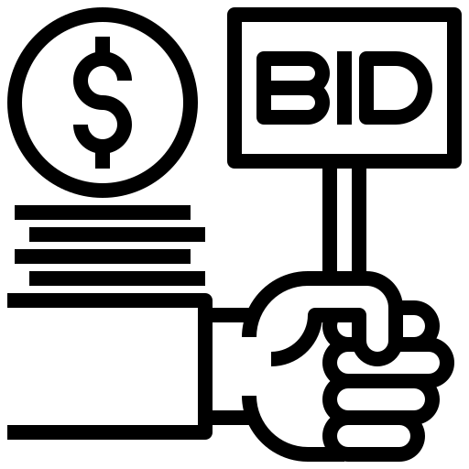
Amazon Bidding for Amazon
E-Commerce Website
Amazon Bidding is an application which allows the customers to bid on the products Amazon sell, It include the new products from Amazon basics, and any customer who has register with amazon to sell products like antiques, Electronics, General goods can use this platform to get great deals from the customers.
Moreover, As we know Amazon is most reputed company with more than 10 Billion users registered in their different platforms like Amazon Prime, Amazon Shopping, Amazon Web Services, Kindle and Amazon Consultants.
With this Platform we target all the Amazon customers and new customers to bid on the product and buy the product from the Amazon Bidding Services.

Slide 3

Why This Project
People from different regions, states, countries participate in the Bidding Contest available in the local market or small third part companies, and unknowingly buying a product without any guarantee or authentication causes loss of money and stress to individuals who bought it.
We recommend customers to use this platform to bid on the products as customer can surf over lot of different products from different cities, state and countries.
Amazon Bidding Services provide world wide customer support which checks for the product authentication, proper value and state of the product (condition) for a seamless bidding and secure experience.
We registered users and selected goods the Prime delivery is available.

Slide 4

Value of This Project
Value Proposition:
Secured Bidding: By leveraging Amazon's reputation and expertise, customers can be assured of product authenticity, accurate value assessment, and proper condition checks before bidding. This eliminates the risk associated with untrusted third-party auctions.
Global Marketplace: Customers can access a vast selection of products from various sellers across different cities, states, and even countries. This broadens their options and potentially allows them to find better deals.
Convenience: Integration with existing Amazon services like Prime delivery streamlines the buying process for registered users.

Slide 5

Vision of This Project
To become the premier platform for secure and convenient online bidding, trusted by both buyers and sellers for its global reach, authenticated products, and seamless user experience.
For Buyers: Confidence in product quality and value, access to a wider selection, secure transactions, potentially lower prices through competitive bidding.
For Sellers: Increased exposure to a global audience, access to a pool of serious buyers interested in bidding, potential for higher selling prices.
For Amazon: Expands its service offerings, attracts new customers, fosters a more engaged user base through bidding activity.

Slide 6

SWOT Analysis
Strengths | Weaknesses | Opportunities | Threats
Market Dominance Increased Revenue Potential Improved Seller Engagement Valuable Data Insights | Complexity Risk of Price Wars Seller Bias User Experience Concerns | Differentiation Global Expansion Customization Options Monetization Potential | Competition Regulatory Concerns Negative Perception Technology Challenges

Slide 7

PESTEL Analysis
Political factors:
Government policies, trade regulations, and leadership influence Amazon's operations
Political stability in developed countries supports Amazon's business
Governmental support for cybersecurity and e-commerce benefits Amazon

Slide 8

PESTEL Analysis
Economic Factors:
Economic stability, disposable incomes, and employment rates impact Amazon's revenue
Amazon's diversified business model contributes to its resilience in varying economic conditions

Slide 9

PESTEL Analysis
Social Factors:
Changing consumer behavior towards online shopping benefit Amazon
Convenience, fast delivery, and consumerism trends drive opportunities for Amazon

Slide 10

PESTEL Analysis
Technological Factors:
Digital evolution & technological advancements like fast delivery options and customer-centric innovations drive Amazon's success
Customer-Centric Technological Solutions - Amazon's focus on technology to replace employees and enhance customer experience

Slide 11

PESTEL Analysis
Environmental Factors:
Sustainability challenges arise from fast delivery promises and greenhouse gas emissions due to Amazon's expanding distribution network
Waste Reduction Efforts - Amazon’s implementation of waste management strategies to address the over-packaging issue

Slide 12

PESTEL Analysis
Legal Factors:
Compliance with international laws, tax regulations, and consumer protection laws are crucial for Amazon's operations
Antitrust laws aim to promote fair competition and monopolistic practices

Slide 13
Current Competitors in Auction Market
eBay
A well-established global auction platform with a vast user base
offers a variety of auction formats, including sealed bids and traditional ascending auctions
Boasts a strong community and established seller network.
Etsy
Specializing in handmade, vintage, and unique goods
While not strictly an auction site, Etsy allows sellers to list items with "make an offer" options, facilitating a bidding-like experience
Caters to a specific audience seeking unique items and fosters a strong sense of community between buyers and crafters

Slide 14
Project Manager’s Strategy
Establish milestones and deliverables
Distribute roles and responsibilities
Feedback loop & progress monitoring
Define Clear Project Objectives
Maintain Clear Communication
Monitor progress & comply with the deadlines
Utilize the right tools: ClickUp
1
2
3
4
5
6
7

Slide 15
Project Charter
An “elevator pitch” of your project objectives, project scope, and project responsibilities in order to get approval from key project stakeholders.

Slide 16
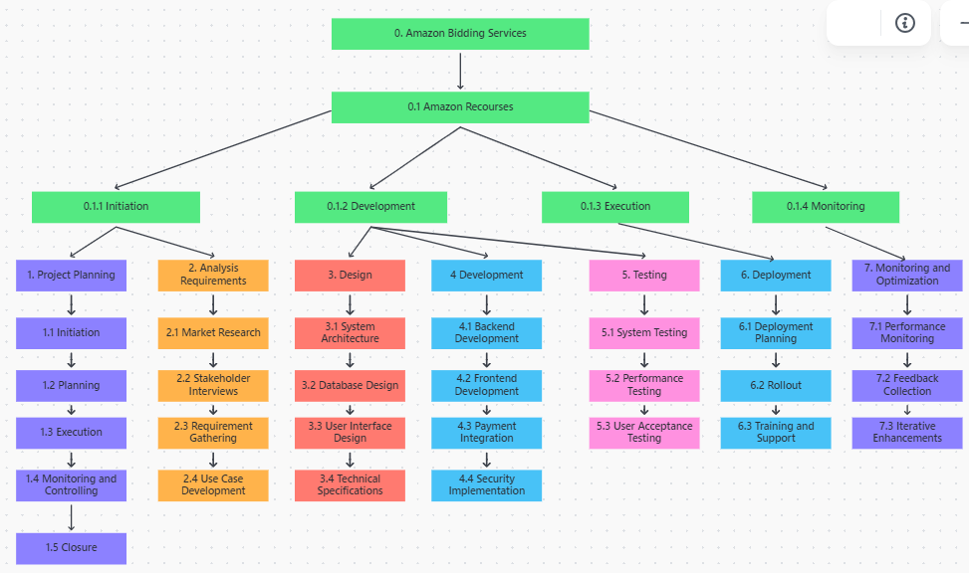
Work Breakdown Structure

Slide 17
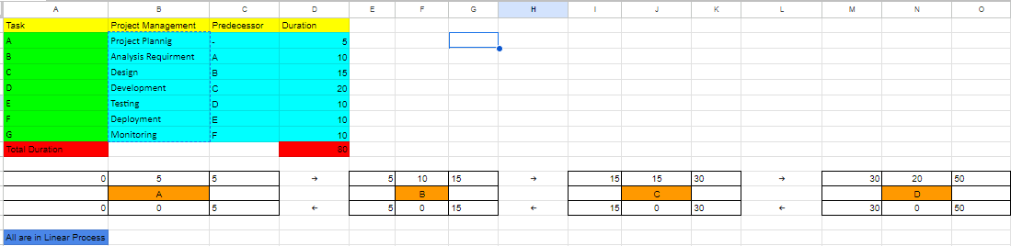
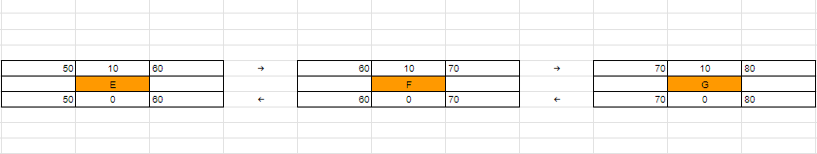
Network Diagram

Slide 18
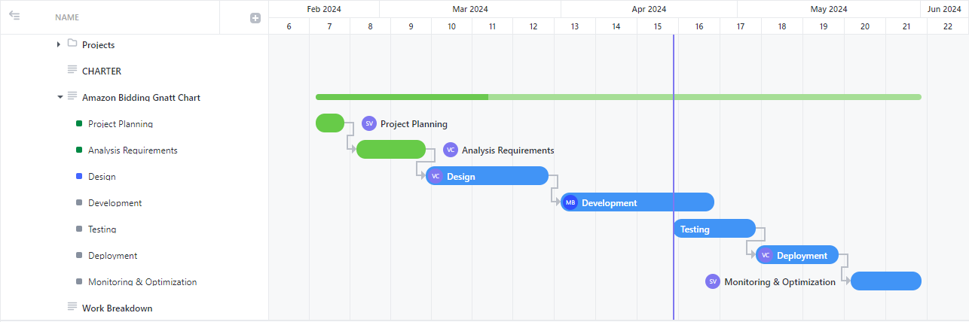
Gantt Chart

Slide 19
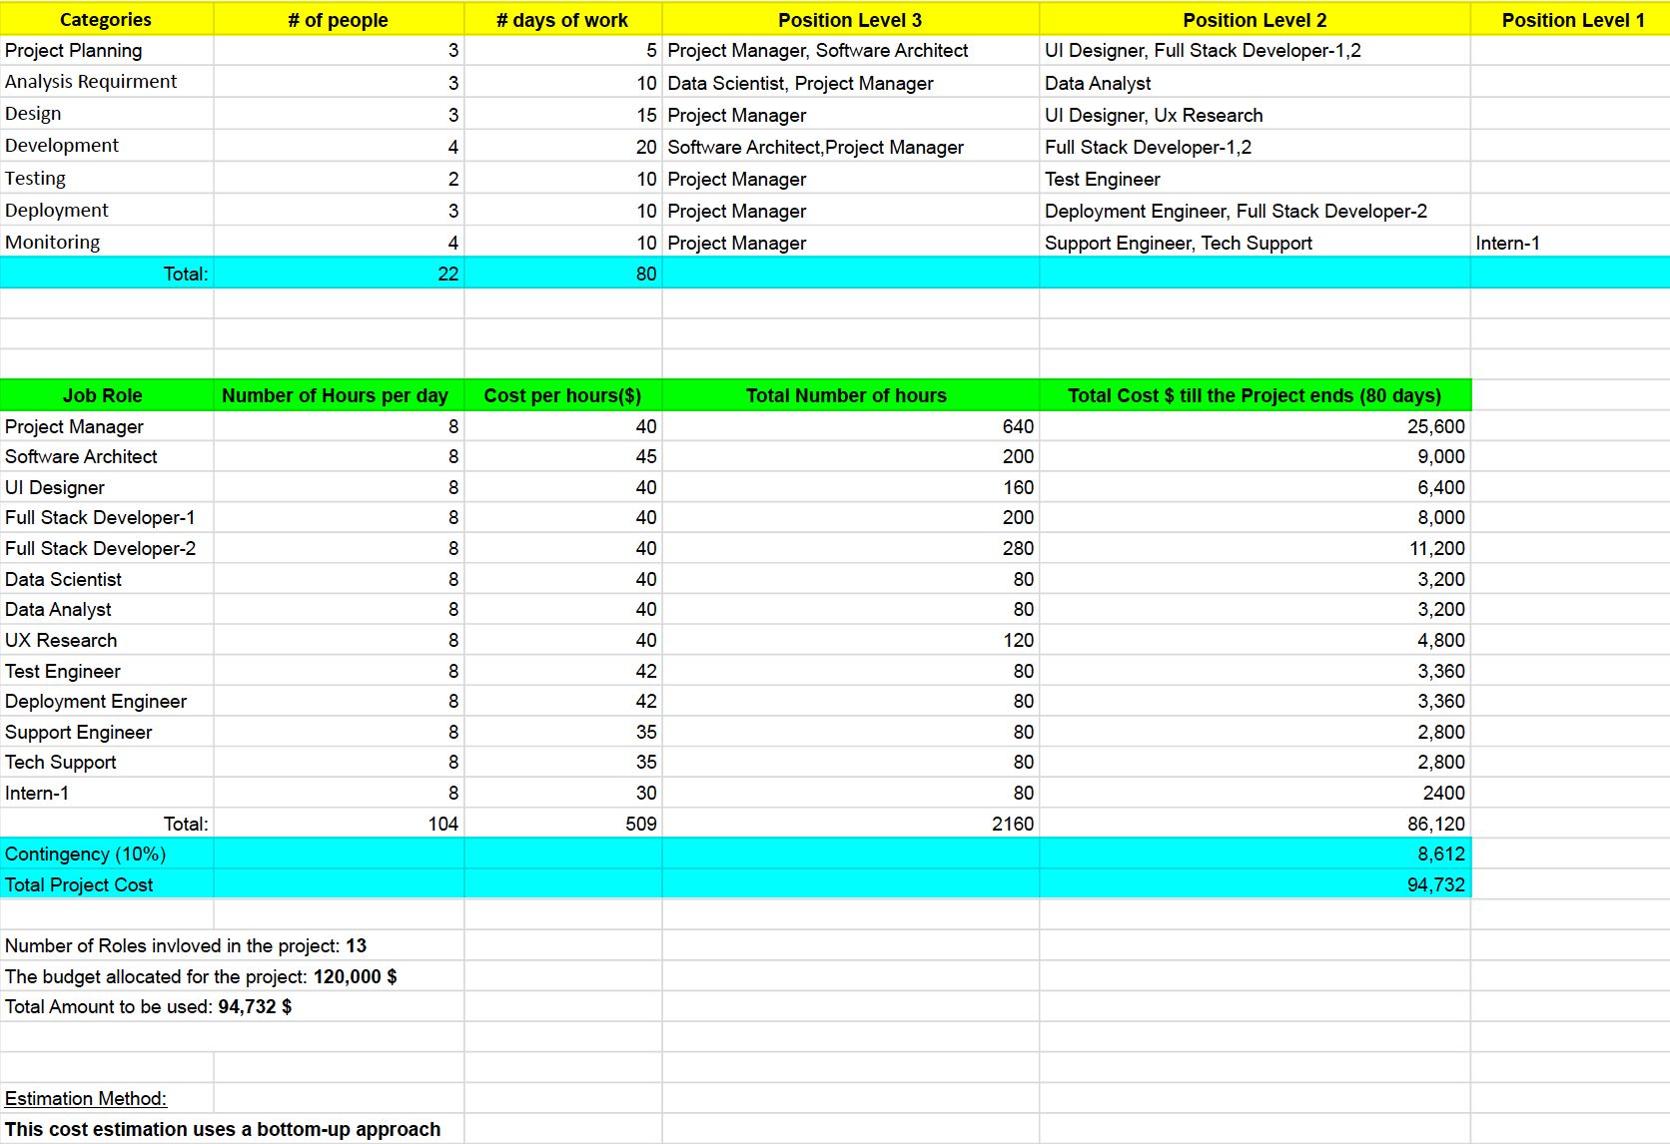
Cost Estimation and Resource Planning

Slide 20
Communication
1. Collaborative approach: Thorough discussions clarified tasks, assigning responsibilities or solving problems collectively.
2. Continuous progress monitoring: Regular checks maintained project standards and ensured alignment with objectives.
3. Inclusive decision-making: Team-wide involvement fostered ownership and commitment to project outcomes.
4. Open communication: Consistent, constructive communication minimized conflicts and enhanced collaboration.
5. Shared goals and vision: Clear objectives motivated team members, driving successful teamwork and project success.

Slide 21
Risks Involved in the Project
User Management Risks:
Risk 1.1: Fraudulent User Accounts
Mitigation: Implement strong authentication protocols and continuous monitoring for suspicious activity.
Bidding Process Risks:
Risk 2.1: Shill Bidding
Mitigation: Analyze bidding patterns and implement bidding limits.
Risk 2.2: Bid Sniping
Mitigation: Consider bid extension or allow maximum bid settings.

Slide 22
Risks Involved in the Project
Payment Processing Risks:
Risk 3.1: Payment Information Compromise
Mitigation: Ensure secure payment processing and partner with reputable providers.
Risk 3.2: Non-Payment by Bid Winners
Mitigation: Require valid payment methods and implement reputation systems.
System Risks:
Risk 4.1: System Performance Issues
Mitigation: Conduct performance testing and implement scalable infrastructure.
Risk 4.2: Security Vulnerabilities
Mitigation: Regular security audits, patch maintenance, and secure data storage practices.

Slide 23
Current Status Report & Monitoring
As of today, here's the status of your ongoing tasks within the Project Management workspace:Design: This task is in progress with urgent priority, under the category "Pricing." It has subtasks including Private task and Private task, both of which are pending.
Development: Assigned to @Maheswar Barrenkala, this task is pending with high priority, categorized under "Market Positioning and Messaging."
Testing: This task is also pending with high priority, scheduled to start today.
Deployment: Assigned to you, this task is pending and scheduled to start on May 4, 2024.
Monitoring & Optimization: Assigned to @Sanmati Vikas, this task is pending under the category "Sales Strategy," with a start date of May 20, 2024.

Slide 24
References
Asana. (n.d.). Asana Guide: Get Started with Asana.
Cleland, D. I., & Ireland, L. R. (2007). Project Management: Strategic Design and Implementation. McGraw-Hill Education.
Project Management Docs. (n.d.). Resource Management Plan Template.
Project Management Institute (PMI). (2021). A Guide to the Project Management Body of Knowledge (PMBOK® Guide) – Seventh Edition.
Reference: Garvin, D. A., & Edmondson, A. C. (2008). Is Yours a Learning Organization? Harvard Business Review.
Schmidt, R. A., & Laforge, R. L. (2015). Management Communication: A Case-Analysis Approach. Pearson.

Slide 25

Thank You!

